Slide 1

Spatial Statistics in Sports
Zach Culp

Slide 2
What is Spatial Statistics?
“Spatial statistics is concerned with statistical methods for data that are spatially referenced, i.e., where the data locations themselves carry information.”
(Cressie, N. A. C. (1993). Statistics for Spatial Data. Wiley.)
Goal: to understand patterns, correlations, and/or dependencies in space

Slide 3
Basis of Spatial Statistical Techniques
Common methods: Ripley’s K, Moran’s I, spatial point process models
Most other methods that deal with spatial statistics are based in regression and machine learning models.
For predictions, the response variable is a function of the (X,Y) coordinates based in mathematics or physics.
For understanding correlation in space, the response is often stochastic

Slide 4
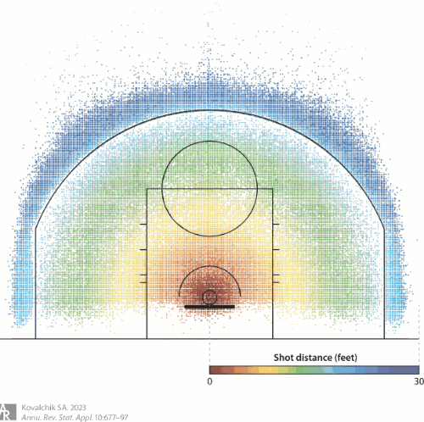
How to do EDA with Spatial Data?
The most commonly used EDA plot in sports is the shot chart
The goal of these plots are to look for potential patterns in the data

Slide 5
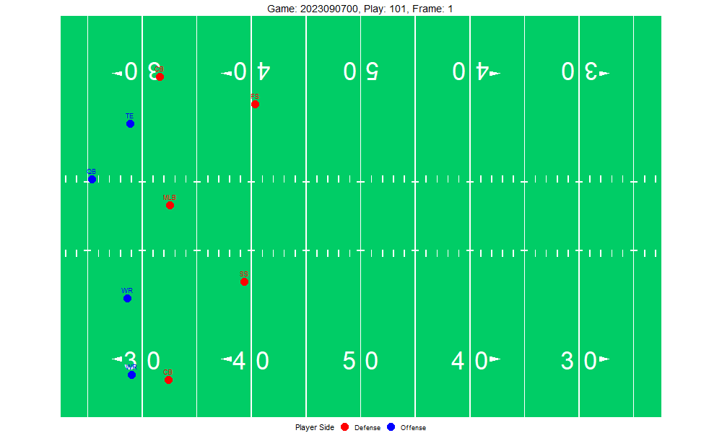
Animating the Data
Function gganimate() in R
Can slow or speed up based on the set frames/second
(X,Y) coordinates over time

Slide 6
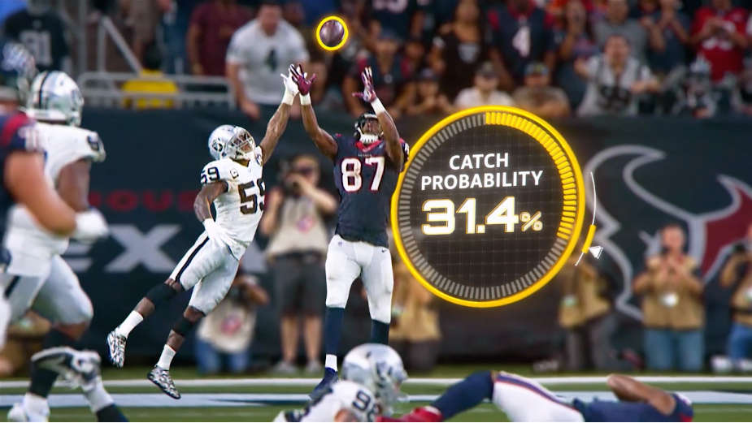
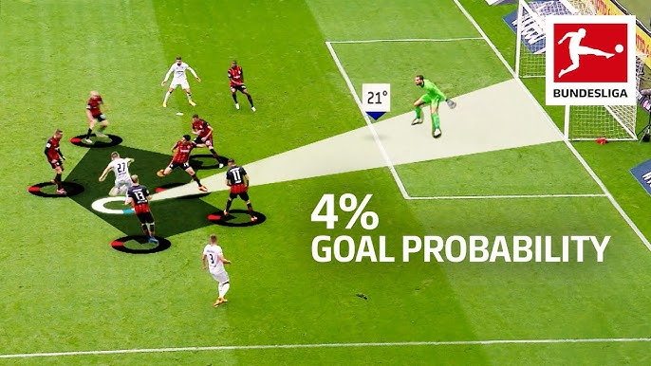
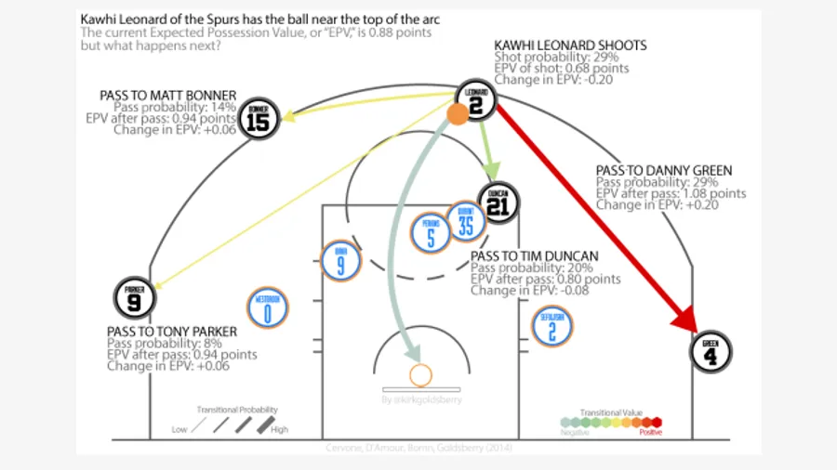
Outcome Probabilities

Slide 7

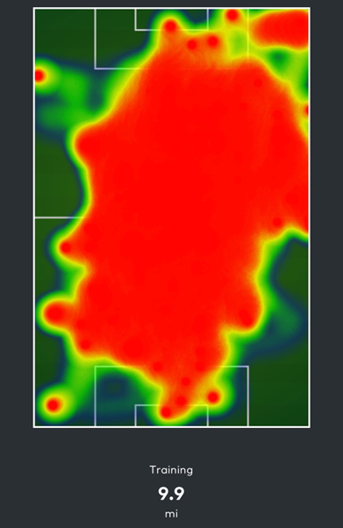
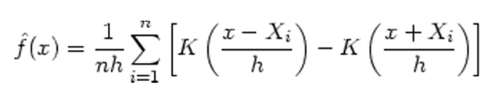
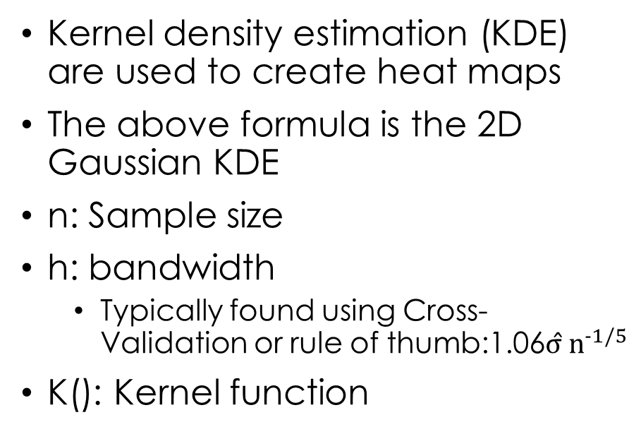
Heat Maps
Kernel density estimation (KDE) are used to create heat maps
The above formula is the 2D Gaussian KDE
n: Sample size
h: bandwidth
  Typically found using Cross-Validation or rule of thumb:1.06$σ̂ n^{-1/5}$
K(): Kernel function

Slide 8
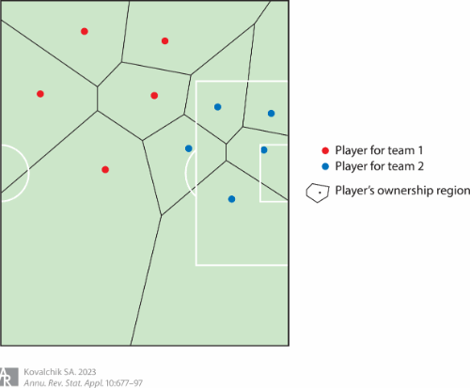
Voronoi Tessellation (Spatial Ownership)
“In a team setting, Voronoi tessellation is the process of assigning each point in the competitive space at a given moment in time to one player according to the player with the minimum Euclidean distance from the point of interest (Phillips 2014).”
Limitations:
  Focuses only on distance, failing to consider other elements that go into player movement

Slide 9


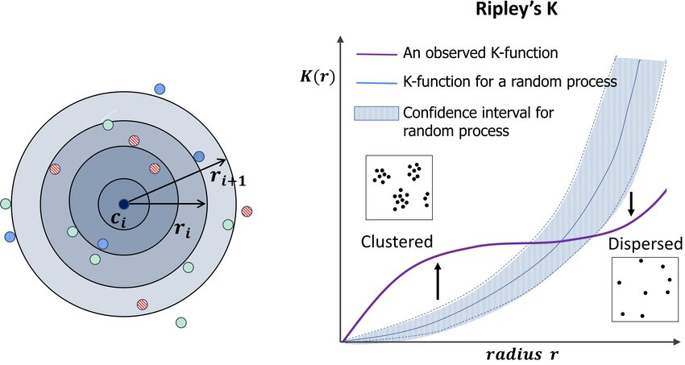
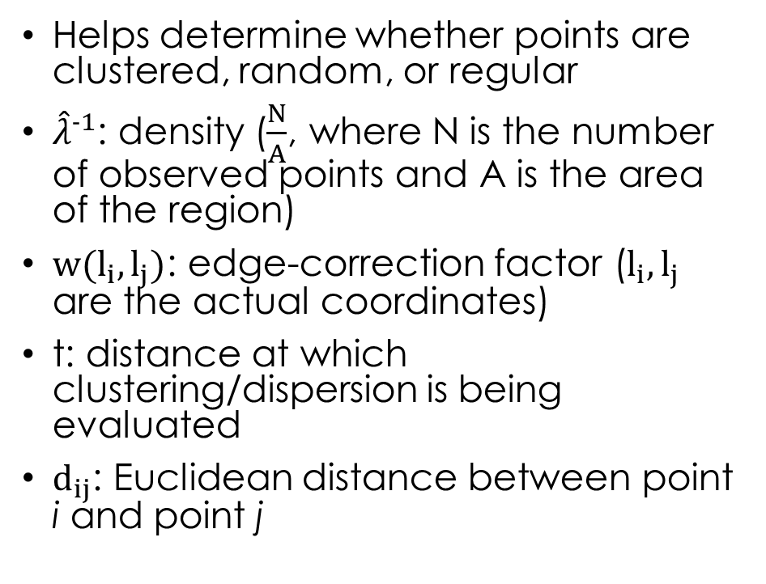
Ripley’s K-function
Helps determine whether points are clustered, random, or regular
${\hat{λ}}^{-1}$: density ($\frac{N}{A}$, where N is the number of observed points and A is the area of the region)
$w(l_{i},l_{j})$: edge-correction factor ($l_{i},l_{j}$ are the actual coordinates)
t: distance at which clustering/dispersion is being evaluated
$d_{ij}$: Euclidean distance between point i and point j

Slide 10
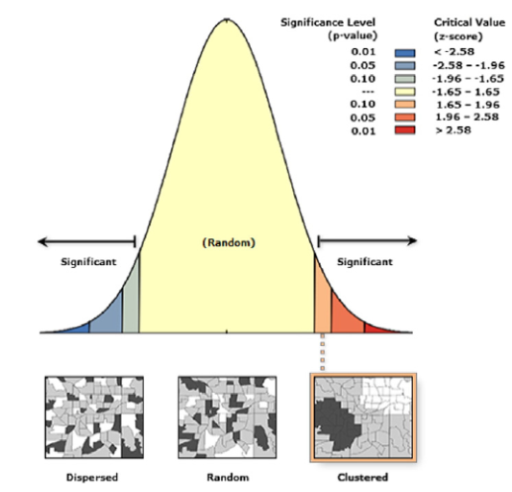
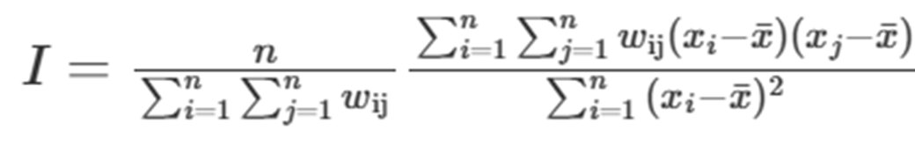
Moran’s I
Spatial autocorrelation: quantifies the degree to which a variable is similar across nearby spatial locations
Similar to Ripley’s K-function (can detect clustering or dispersion)

Slide 11
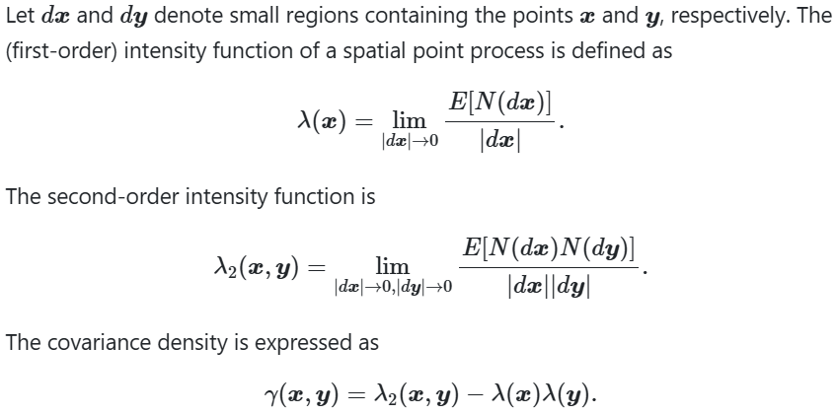
Spatial point process models
Used to analyze the location and pattern of events
Formula is calculating the expected number of events per unit area at location x
In other words, the “intensity” of events at a given location
Higher value means more events are expected
Homogeneous and Inhomogeneous Poisson Processes are common processes

Slide 12
Comparing Methods and Limitations
Method | Best Used When | Purpose | Limitations
Ripley’s K Function | Testing if point locations are random, clustered, or regular | Detecting spatial clustering or dispersion at multiple distance scales | • Assumes homogeneous process • Only tests for pattern, doesn't explain why patterns exist • Sensitive to edge effects (boundary bias) • Cannot incorporate covariates • Requires stationarity assumption
Moran’s I | Analyzing spatial autocorrelation in continuous variables | Measuring whether similar values cluster together spatially | • Requires defining spatial weights • Works on aggregated/areal data, not individual points • Only provides global measure • Cannot model underlying intensity • Assumes constant spatial relationship
Point Process Models | Modelling and predicting point locations; understanding patterns | Modelling the underlying process that generates point patterns; predictions | • Requires assumptions about underlying distribution; overdispersion issues if assumptions are violated • Complex to fit and interpret • Requires knowledge of study window/boundaries

Slide 13
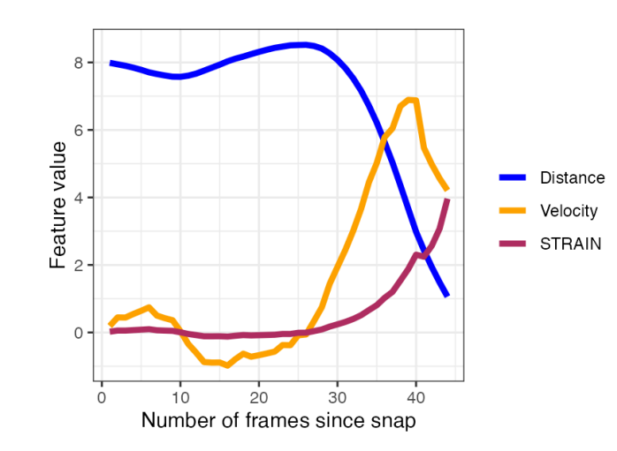
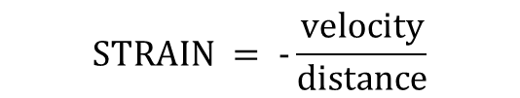
Metrics
$$STRAIN = -\frac{velocity}{distance}$$
Because most of the methods are harder to interpret and conceptualize for the average sports fan, many statisticians started to use metrics that are usually based on physics to help explain trends
Some simple examples are acceleration, total distance covered, kinetic energy estimates, STRAIN (Speed-Time Relative Acceleration INdex)
Quang Nguyen

Slide 14

Questions/Comments?

Slide 15
Works Cited
Oksanen, J., Bergman, C., Sainio, J., & Westerholm, J. (2015). Methods for deriving and calibrating privacy-preserving heat maps from mobile sports tracking application data. Journal of Transport Geography, 48, 135–144. https://doi.org/10.1016/j.jtrangeo.2015.09.001
Kovalchik, S. A. (2023). Player tracking data in sports. Annual Review of Statistics and Its Application, 10, 677–697. https://doi.org/10.1146/annurev-statistics-033021-110117
Abousamra, Shahira & Gupta, Rajarsi & Kurc, Tahsin & Saltz, Joel & Chen, Chao. (2023). Topology-Guided Multi-Class Cell Context Generation for Digital Pathology. 10.48550/arXiv.2304.02255.
Papa, Anna & Sidira, Persefoni & Tsatsaris, Andreas. (2016). Spatial cluster analysis of Crimean-Congo hemorrhagic fever virus seroprevalence in humans, Greece. Parasite Epidemiology and Control. 1. 10.1016/j.parepi.2016.08.002.
Spatial point processes and simulation. In Spatial Statistics for Data Science: Theory and Practice with R. https://www.paulamoraga.com/book-spatial/spatial-point-processes-and-simulation.html

